Slide 1
Chapter 3: Introduction to SQL

Slide 2
Outline
Overview of The SQL Query Language
SQL Data Definition
Basic Query Structure of SQL Queries
Additional Basic Operations
Set Operations
Null Values
Aggregate Functions
Nested Subqueries
Modification of the Database
Notes:
1

Slide 3
History
IBM Sequel language developed as part of System R project at the IBM San Jose Research Laboratory
Renamed Structured Query Language (SQL)
ANSI and ISO standard SQL:
SQL-86
SQL-89
SQL-92
SQL:1999 (language name became Y2K compliant!)
SQL:2003
Commercial systems offer most, if not all, SQL-92 features, plus varying feature sets from later standards and special proprietary features.
Not all examples here may work on your particular system.

Slide 4
SQL Parts
DML -- provides the ability to query information from the database and to insert tuples into, delete tuples from, and modify tuples in the database.
integrity – the DDL includes commands for specifying integrity constraints.
View definition -- The DDL includes commands for defining views.
Transaction control –includes commands for specifying the beginning and ending of transactions.
Embedded SQL and dynamic SQL -- define how SQL statements can be embedded within general-purpose programming languages.
Authorization – includes commands for specifying access rights to relations and views.

Slide 5
Data Definition Language
The SQL data-definition language (DDL) allows the specification of information about relations, including:
The schema for each relation.
The type of values associated with each attribute.
The Integrity constraints
The set of indices to be maintained for each relation.
Security and authorization information for each relation.
The physical storage structure of each relation on disk.

Slide 6
Domain Types in SQL
char(n). Fixed length character string, with user-specified length n.
varchar(n). Variable length character strings, with user-specified maximum length n.
int. Integer (a finite subset of the integers that is machine-dependent).
smallint. Small integer (a machine-dependent subset of the integer domain type).
numeric(p,d). Fixed point number, with user-specified precision of p digits, with d digits to the right of decimal point. (ex., numeric(3,1), allows 44.5 to be stores exactly, but not 444.5 or 0.32)
real, double precision. Floating point and double-precision floating point numbers, with machine-dependent precision.
float(n). Floating point number, with user-specified precision of at least n digits.
More are covered in Chapter 4.

Slide 7
Create Table Construct
An SQL relation is defined using the create table command:
create table r
(A₁ D₁, A₂ D₂, ..., A_{n} D_{n}, (integrity-constraint₁), ..., (integrity-constraint_{k}))
r is the name of the relation
each A_{i} is an attribute name in the schema of relation r
D_{i} is the data type of values in the domain of attribute A_{i}
Example:
create table instructor ( ID char(5), name varchar(20), dept_name varchar(20), salary numeric(8,2))

Slide 8
Integrity Constraints in Create Table
Types of integrity constraints
primary key (A₁, ..., A_{n} )
foreign key (A_{m}, ..., A_{n} ) references r
not null
SQL prevents any update to the database that violates an integrity constraint.
Example:
create table instructor ( ID char(5), name varchar(20) not null, dept_name varchar(20), salary numeric(8,2), primary key (ID), foreign key (dept_name) references department);

Slide 9
And a Few More Relation Definitions
create table student ( ID varchar(5), name varchar(20) not null, dept_name varchar(20), tot_cred numeric(3,0), primary key (ID),
foreign key (dept_name) references department);
create table takes ( ID varchar(5), course_id varchar(8), sec_id varchar(8), semester varchar(6), year numeric(4,0), grade varchar(2),
primary key (ID, course_id, sec_id, semester, year) ,
foreign key (ID) references student, foreign key (course_id, sec_id, semester, year) references section);

Slide 10
And more still
create table course ( course_id varchar(8), title varchar(50), dept_name varchar(20), credits numeric(2,0),
primary key (course_id),
foreign key (dept_name) references department);

Slide 11
Updates to tables
Insert
insert into instructor values ('10211', 'Smith', 'Biology', 66000);
Delete
Remove all tuples from the student relation
delete from student
Drop Table
drop table r
Alter
alter table r add A D
where A is the name of the attribute to be added to relation r and D is the domain of A.
All exiting tuples in the relation are assigned null as the value for the new attribute.
alter table r drop A
where A is the name of an attribute of relation r
Dropping of attributes not supported by many databases.

Slide 12
Basic Query Structure
A typical SQL query has the form: select A₁, A₂, ..., A_{n} from r₁, r₂, ..., r_{m} where P
A_{i} represents an attribute
R_{i} represents a relation
P is a predicate.
The result of an SQL query is a relation.
Notes:
2

Slide 13
The select Clause
The select clause lists the attributes desired in the result of a query
corresponds to the projection operation of the relational algebra
Example: find the names of all instructors: select name from instructor
NOTE: SQL names are case insensitive (i.e., you may use upper- or lower-case letters.)
E.g., Name ≡ NAME ≡ name
Some people use upper case wherever we use bold font.
Notes:
3

Slide 14
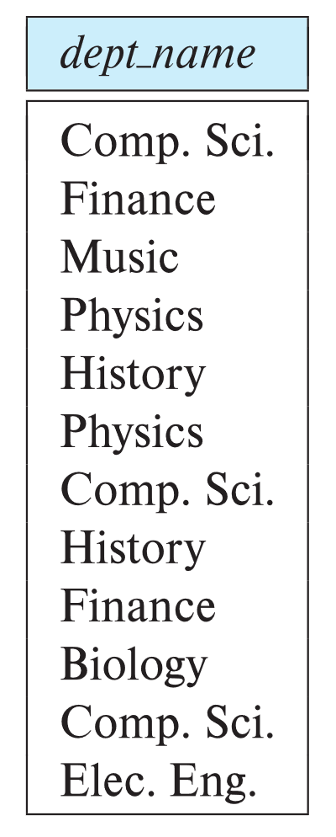
The select Clause (Cont.)
SQL allows duplicates in relations as well as in query results.
To force the elimination of duplicates, insert the keyword distinct after select.
Find the department names of all instructors, and remove duplicates
select distinct dept_name from instructor
The keyword all specifies that duplicates should not be removed.
select all dept_name from instructor
Notes:
4

Slide 15
The select Clause (Cont.)
An asterisk in the select clause denotes “all attributes”
select * from instructor
An attribute can be a literal with no from clause
select '437'
Results is a table with one column and a single row with value “437”
Can give the column a name using:
select '437' as FOO
An attribute can be a literal with from clause
select 'A' from instructor
Result is a table with one column and N rows (number of tuples in the instructors table), each row with value “A”
Notes:
5

Slide 16
The select Clause (Cont.)
The select clause can contain arithmetic expressions involving the operation, +, –, ∗, and /, and operating on constants or attributes of tuples.
The query:
select ID, name, salary/12 from instructor
would return a relation that is the same as the instructor relation, except that the value of the attribute salary is divided by 12.
Can rename “salary/12” using the as clause:
select ID, name, salary/12 as monthly_salary
Notes:
5

Slide 17
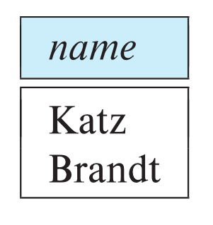
The where Clause
The where clause specifies conditions that the result must satisfy
Corresponds to the selection predicate of the relational algebra.
To find all instructors in Comp. Sci. dept
select name from instructor where dept_name = 'Comp. Sci.'
SQL allows the use of the logical connectives and, or, and not
The operands of the logical connectives can be expressions involving the comparison operators <, <=, >, >=, =, and <>.
Comparisons can be applied to results of arithmetic expressions
To find all instructors in Comp. Sci. dept with salary > 70000
select name from instructor where dept_name = 'Comp. Sci.' and salary > 70000
Notes:
6

Slide 18
The from Clause
The from clause lists the relations involved in the query
Corresponds to the Cartesian product operation of the relational algebra.
Find the Cartesian product instructor X teaches
select ∗ from instructor, teaches
generates every possible instructor – teaches pair, with all attributes from both relations.
For common attributes (e.g., ID), the attributes in the resulting table are renamed using the relation name (e.g., instructor.ID)
Cartesian product not very useful directly, but useful combined with where-clause condition (selection operation in relational algebra).
Notes:
8

Slide 19
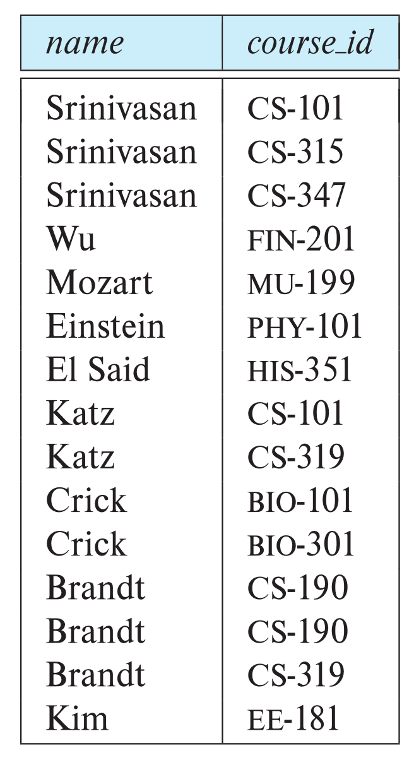
Examples
Find the names of all instructors who have taught some course and the course_id
select name, course_id from instructor , teaches where instructor.ID = teaches.ID
Find the names of all instructors in the Art department who have taught some course and the course_id
select name, course_id from instructor , teaches where instructor.ID = teaches.ID and instructor. dept_name = 'Art'
Notes:
9

Slide 20
The Rename Operation
The SQL allows renaming relations and attributes using the as clause:
old-name as new-name
Find the names of all instructors who have a higher salary than some instructor in 'Comp. Sci'.
select distinct T.name from instructor as T, instructor as S where T.salary > S.salary and S.dept_name = 'Comp. Sci.’
Keyword as is optional and may be omitted instructor as T ≡ instructor T
Notes:
9

Slide 21
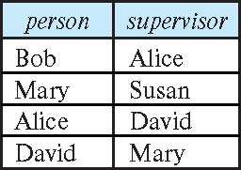
Self Join Example
Relation emp-super
Find the supervisor of “Bob”
Find the supervisor of the supervisor of “Bob”
Can you find ALL the supervisors (direct and indirect) of “Bob”?
Notes:
9

Slide 22
String Operations
SQL includes a string-matching operator for comparisons on character strings. The operator like uses patterns that are described using two special characters:
percent ( % ). The % character matches any substring.
underscore ( _ ). The _ character matches any character.
Find the names of all instructors whose name includes the substring “dar”.
select name from instructor where name like '%dar%'
Match the string “100%”
like '100 \%' escape '\'
in that above we use backslash (\) as the escape character.

Slide 23
String Operations (Cont.)
Patterns are case sensitive.
Pattern matching examples:
'Intro%' matches any string beginning with “Intro”.
'%Comp%' matches any string containing “Comp” as a substring.
'_ _ _' matches any string of exactly three characters.
'_ _ _ %' matches any string of at least three characters.
SQL supports a variety of string operations such as
concatenation (using “||”)
converting from upper to lower case (and vice versa)
finding string length, extracting substrings, etc.

Slide 24
Ordering the Display of Tuples
List in alphabetic order the names of all instructors
select distinct name from instructor order by name
We may specify desc for descending order or asc for ascending order, for each attribute; ascending order is the default.
Example: order by name desc
Can sort on multiple attributes
Example: order by dept_name, name

Slide 25
Where Clause Predicates
SQL includes a between comparison operator
Example: Find the names of all instructors with salary between $90,000 and $100,000 (that is, ≥ $90,000 and ≤ $100,000)
select name from instructor where salary between 90000 and 100000
Tuple comparison
select name, course_id from instructor, teaches where (instructor.ID, dept_name) = (teaches.ID, 'Biology');
Notes:
7

Slide 26
Set Operations
Find courses that ran in Fall 2017 or in Spring 2018
(select course_id from section where sem = 'Fall' and year = 2017) union (select course_id from section where sem = 'Spring' and year = 2018)
Find courses that ran in Fall 2017 and in Spring 2018
(select course_id from section where sem = 'Fall' and year = 2017) intersect (select course_id from section where sem = 'Spring' and year = 2018)
Find courses that ran in Fall 2017 but not in Spring 2018
(select course_id from section where sem = 'Fall' and year = 2017) except (select course_id from section where sem = 'Spring' and year = 2018)

Slide 27
Set Operations (Cont.)
Set operations union, intersect, and except
Each of the above operations automatically eliminates duplicates
To retain all duplicates use the
union all,
intersect all
except all.

Slide 28
Null Values
It is possible for tuples to have a null value, denoted by null, for some of their attributes
null signifies an unknown value or that a value does not exist.
The result of any arithmetic expression involving null is null
Example: 5 + null returns null
The predicate is null can be used to check for null values.
Example: Find all instructors whose salary is null.
select name from instructor where salary is null
The predicate is not null succeeds if the value on which it is applied is not null.

Slide 29
Null Values (Cont.)
SQL treats as unknown the result of any comparison involving a null value (other than predicates is null and is not null).
Example: 5 < null or null <> null or null = null
The predicate in a where clause can involve Boolean operations (and, or, not); thus the definitions of the Boolean operations need to be extended to deal with the value unknown.
and : (true and unknown) = unknown, (false and unknown) = false, (unknown and unknown) = unknown
or: (unknown or true) = true, (unknown or false) = unknown (unknown or unknown) = unknown
Result of where clause predicate is treated as false if it evaluates to unknown

